Slide 1

Dr.B.R.AMBEDKAR UNIVERSITY,SRIKAKULAM
College Of Engineering
Master of Computer Application
Presented by:
Nadukuru.Sai Santoshi
Reg.no:2251926019
Under the guidance of:
Dr.Goddu.Ramakrishna
Assistant Professor
1

Slide 2
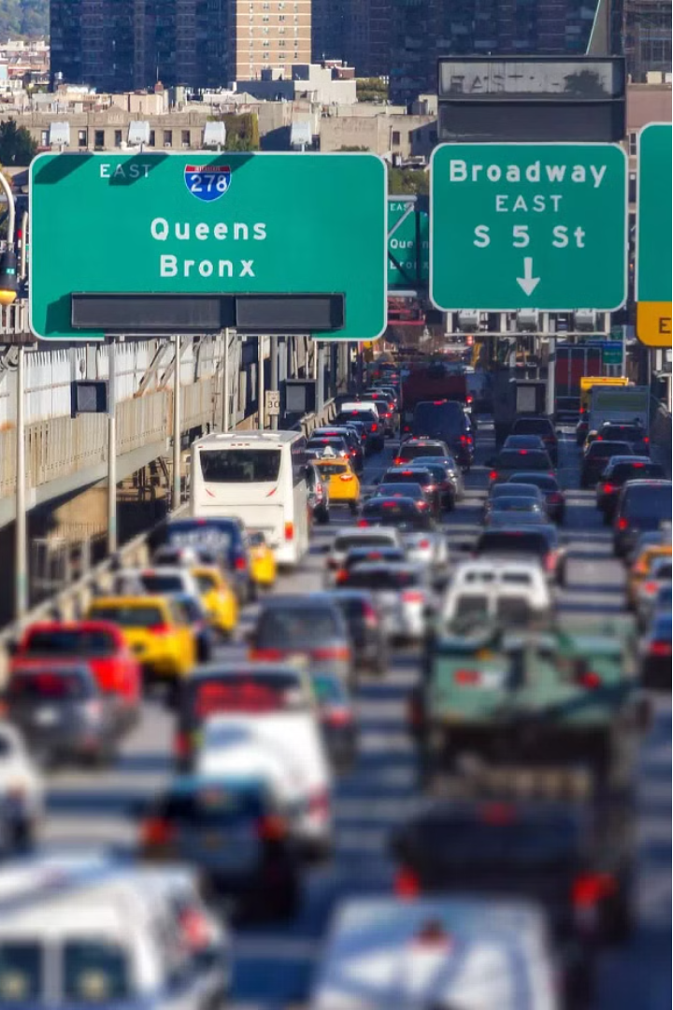
SMART TRAFFIC DETECTION
a2

Slide 3
ABSTRACT:
As the problem of urban traffic congestion intensifies, there is a pressing need for the introduction of advanced technology and equipment to improve the state-of-the-art of traffic control. the current methods used such as timers or human control are proved to be inferior to alleviate this crisis. In this project, a system to control the traffic by measuring the real-time vehicle density using canny edge detection with digital image processing is proposed. This imposing traffic control system offers significant improvement in response time, vehicle management, automation, reliability and overall efficiency over the existing systems. As the problem of urban traffic congestion intensifies, there is a pressing need for the introduction of advanced technology and equipment to improve the state-of-the-art of traffic control. Besides that, the complete technique from image acquisition to edge detection and finally green signal allotment using four sample images of different traffic conditions is illustrated with proper schematics and the final results are verified by hardware implementation.
3

Slide 4
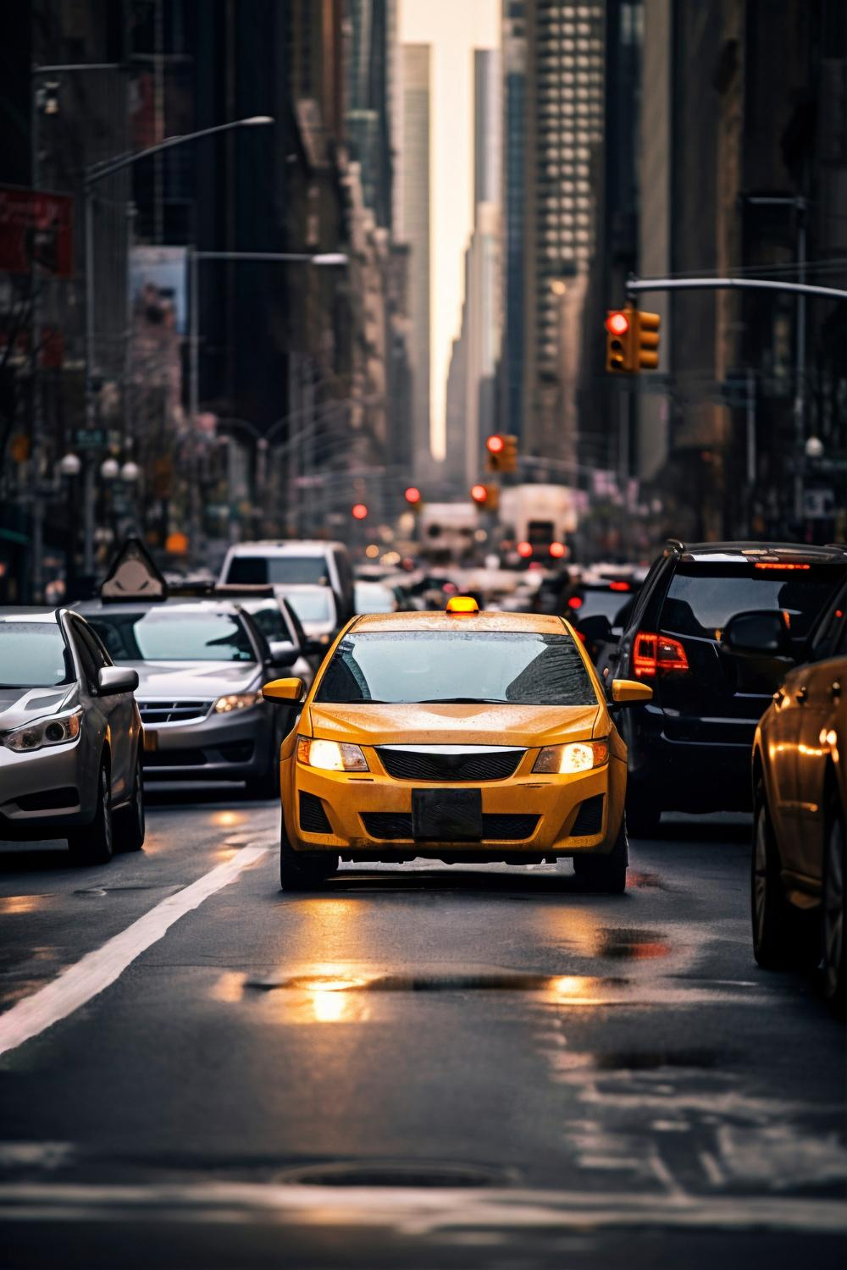
Traffic management is an issue which impacts us almost daily. Use of the technology and real time analysis can actually lead to a smooth traffic management . The common reason for traffic congestion is due to poor traffic prioritization.
MOTIVATION:
* Traffic management is an issue which impacts us almost daily. Use of the technology and real time analysis can actually lead to a smooth traffic management . The common reason for traffic congestion is due to poor traffic prioritization.
4

Slide 5
PROBLEM STATEMENT:
In the past, induction loops and infrared light sensors were two examples of various systems for collecting traffic data, each with its own set of limitations. Combining continuous traffic data from CCTV footage captured near traffic lights has recently yielded promising results for image processing. There are a lot of different ways to measure how many people attend social events. Others count the number of cars, while some count the overall amount of pixels. These methods have produced excellent outcomes in terms of the traffic metrics associated with social events. Regardless, handling countless vehicles might neglect to merge truck or auto-truck as vehicles, which are famous methods of transportation in South Asian nations, and may bring about misdirecting results if intra vehicular apportioning is little (two vehicles near one another might be considered to be one). Furthermore, a traffic officer (Cop) is in charge of traffic control under current regulations.
5

Slide 6
OBJECTIVES:
1. The project processed a system for controlling the traffic light by image processing..
2. In this system ,the vehicles are not being detected by sensors , rather it is detected by images.
3 . In this process initially the system will have picture of the traffic road and the system will
continuously taking pictures of the road and will compare those with traffic ones which will
gives signal of the density of vehicles present on the road.
6

Slide 7
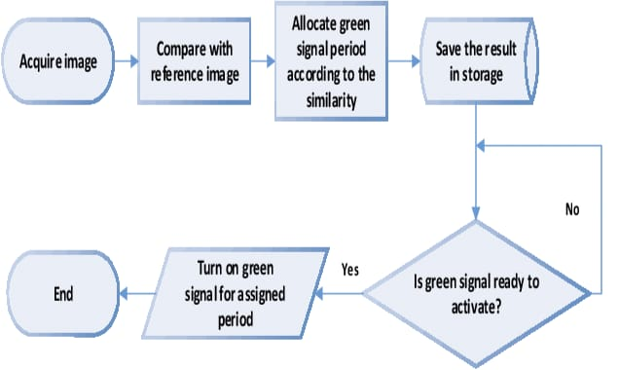
ARCHITECTURE:
7

Slide 8
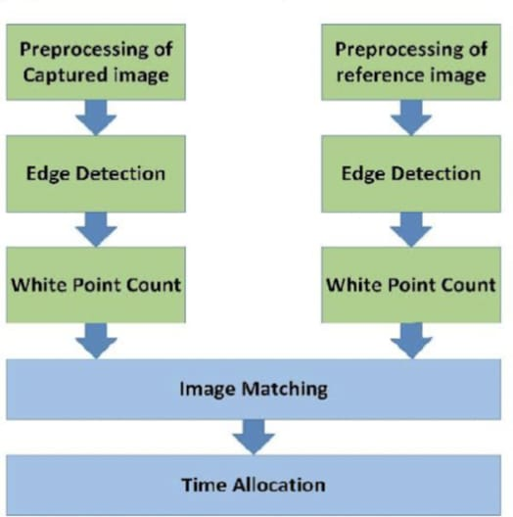
METHODOLOGY:
8

Slide 9
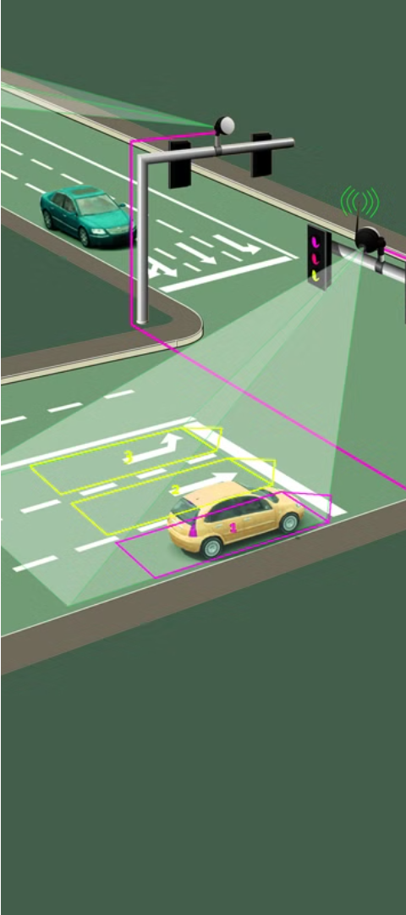
MODULES:
1.To finish this project, we utilized the following modules.
2.In step 1,we will upload the traffic image.
3.In next step, we will detect the image.
4.Image pre-processing is done using Canny Edge Detection Algorithm.
5.Finding out the white pixel count by applying the Gaussian filter.
6.The last step is allocation of the Green signal Time.
9

Slide 10

IMAGE PROCESSING :
image preprocessing is performed to convert the raw images into more accessible form for edge detection purpose. At first, four images of different traffic scenario are selected and image of the empty road is chosen as reference image. All the images are then resized into 400*400 pixel using the following formula for constant spatial resolution and greater computational efficiency.
Original height/original width*new width = new height
Original width/original height*new height = new width
VEHICLE DETECTION AND COUNTING:
Automatic detecting and counting vehicles in unsupervised video on highways is a very challenging problem in computer vision with important practical applications such as to monitor activities at traffic intersections for detecting congestions, and then predict the traffic /of which assists in regulating traffic. Manually reviewing the large amount of data they generate is often impractical.
PRE-PROCESSING OF CAPTURED IMAGE:
Image pre-processing is performed to convert the raw images into more accessible form for edge detection. As Gray scale images have superior signal to noise ratio compared to RGB image, it is advantageous to convert RGB images into Gray scale for further processing. The following equation is used to convert each pixel in the image to its equivalent Gray scale
10

Slide 11
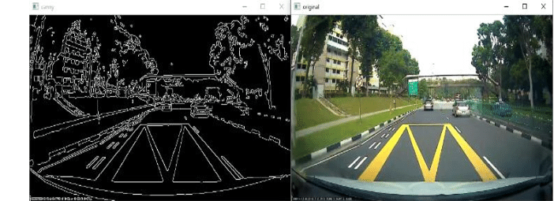
Concept of Edge Detection:
The concept of edge detection is used to detect the location and presence of edges by making changes in the intensity of an image. Different operations are used in image processing to detect edges. It can detect the variation of grey levels but it quickly gives response when a noise is detected. In image processing, edge detection is a very important task. Edge detection is the main tool in pattern recognition, image segmentation and scene analysis. It is a type of filter which is applied to extract the edge points in an image. Sudden changes in an image occurs when the edge of an image contour across the brightness of the image.
Canny edge detection algorithm:
Canny Edge Detector is found to be most suitable for this application. Images are smoothed by applying Gaussian filter
to reduce unwanted texture and details.
The Canny Edge Detection algorithm can be broken down into the five following steps:
Apply Gaussian filter to smoothen the image in order to remove the noise
Find the intensity gradients of the image
Apply non-maximum suppression to get rid of spurious response to edge detection
Apply double threshold to determine potential edges
Track edge by hysteresis: Finalize the detection of edges by suppressing all the other edges that are weak and not connected to strong edges
11

Slide 12
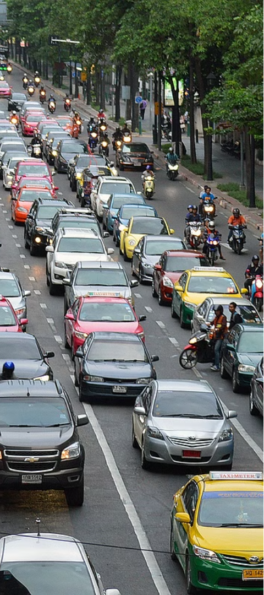
WHITE POINT COUNTS:
A white point is a set of values or that serve to define the color "white" in
image capture encoding, or reproduction. It is used to calculate the traffic density by comparing
the number of white pixels to the number of black pixels.
This gives an estimation of the traffic density in the lane.
TIME ALLOCATION:
Time allocation is done based upon the white point count of the traffic on the road
at that particular time. The number of white pixels of the edge detected image and total number
of pixels gives the density percentage.
%density= No. of white pixels /Total No. of pixels
If the density is between 0 to 10% - green light is on for 10 seconds.
If the density is between 10 to 50% - green light is on for 30 seconds.
If the density is between 50 to 70% - green light is on for 40 seconds.
If the density is between 70 to 90% - green light is on for 60 seconds.
If the density is between 90 to 100% - green light is on for 90 seconds
12

Slide 13
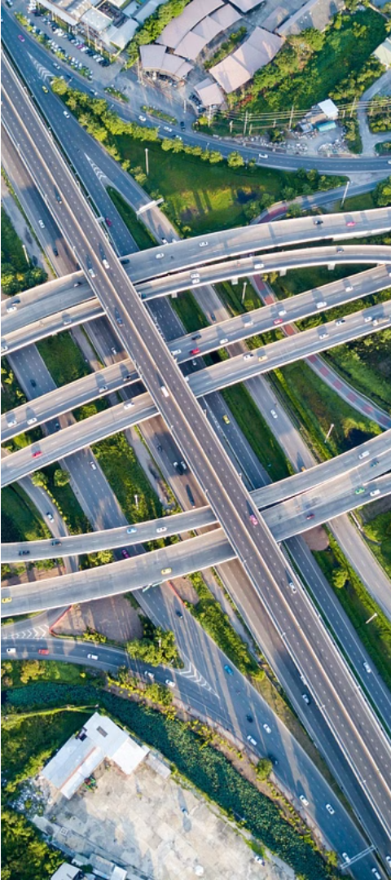
Conclusion:
The system presents a novel approach, based on Canny Edge Detection (CED) algorithm to construct a traffic management system, with the aim of improving the traffic conditions. In this proposed system, the images are captured at intersections, and then they are processed using CED algorithm. After that, the calculation of the density of the traffic is done using the white point count, and dynamically the signal times are changed depending on the intensity of traffic. Therefore, the system autonomously controls the traffic, involving lower human power with virtually no new installation cost. This model is an attempt to detect the density of vehicles on road in real time. The implementation of the proposed system will help in attaining great accuracy
13

Slide 14
Thank you

